Slide 1
Proof of Minting and Verification of Sale
What METASALT does

Slide 2
User authorization page
Super user
Authorization
Brand control
Database architecture
Lazy Minting option

Slide 3
On your phone, metamask installed
Can navigate to metasalt.io
Polygon testnet Mumbai – chain properly connected to metamask
Have tokens
Pre-Mint - NFTs

Slide 4
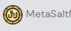


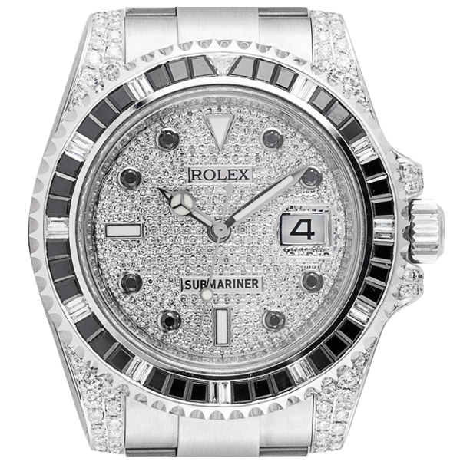


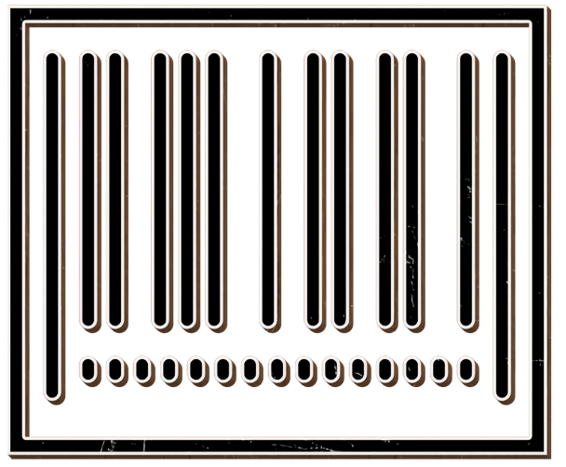
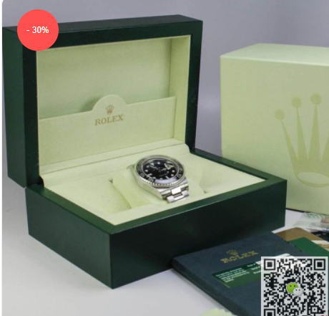
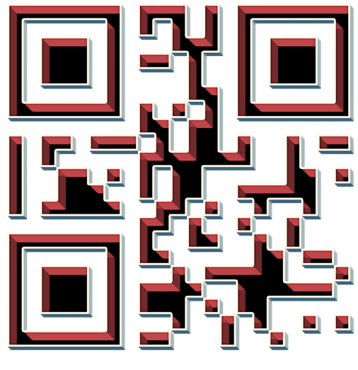

Question
Was this NFT of Submariner watch minted at Rolex Store?
Reward
1 Metasalt for creating NFT
UserName:
Salesperson
Marketplace.sol

Slide 5
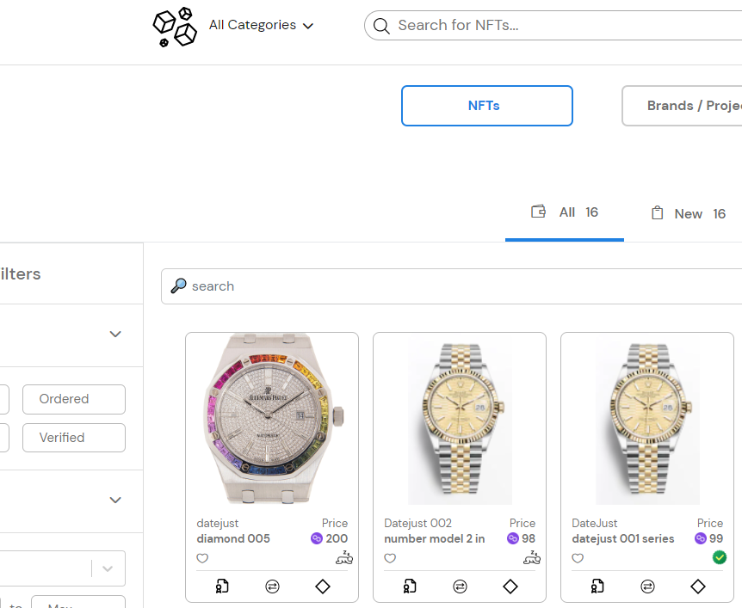
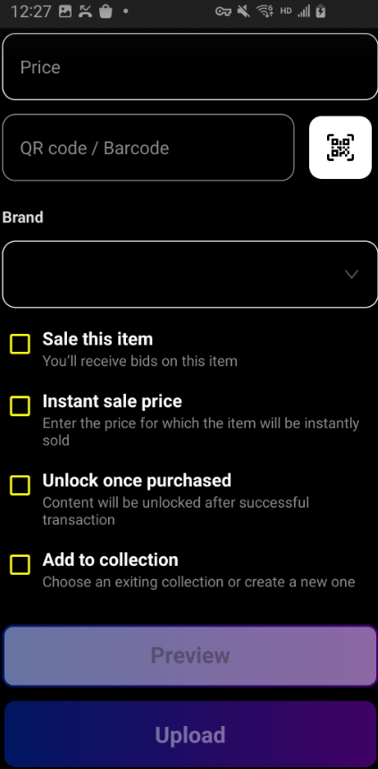
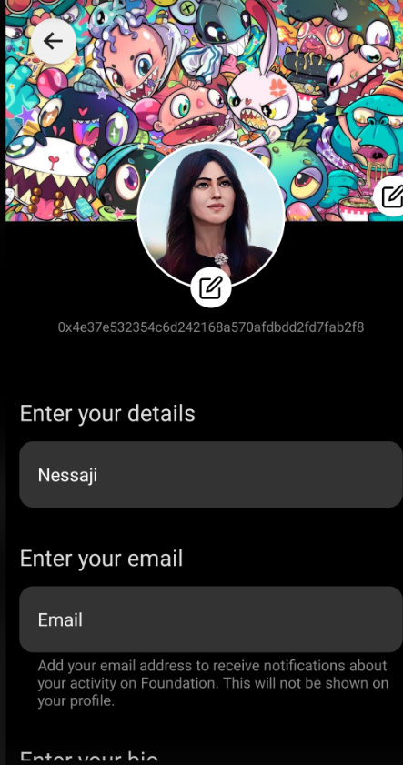
Question
How is NFT transferred to Buyer’s wallet?
?
Buyer
Salesperson

Slide 6
Question
How is NFT transferred to Buyer’s wallet?
?
Buyer
Salesperson

Slide 7

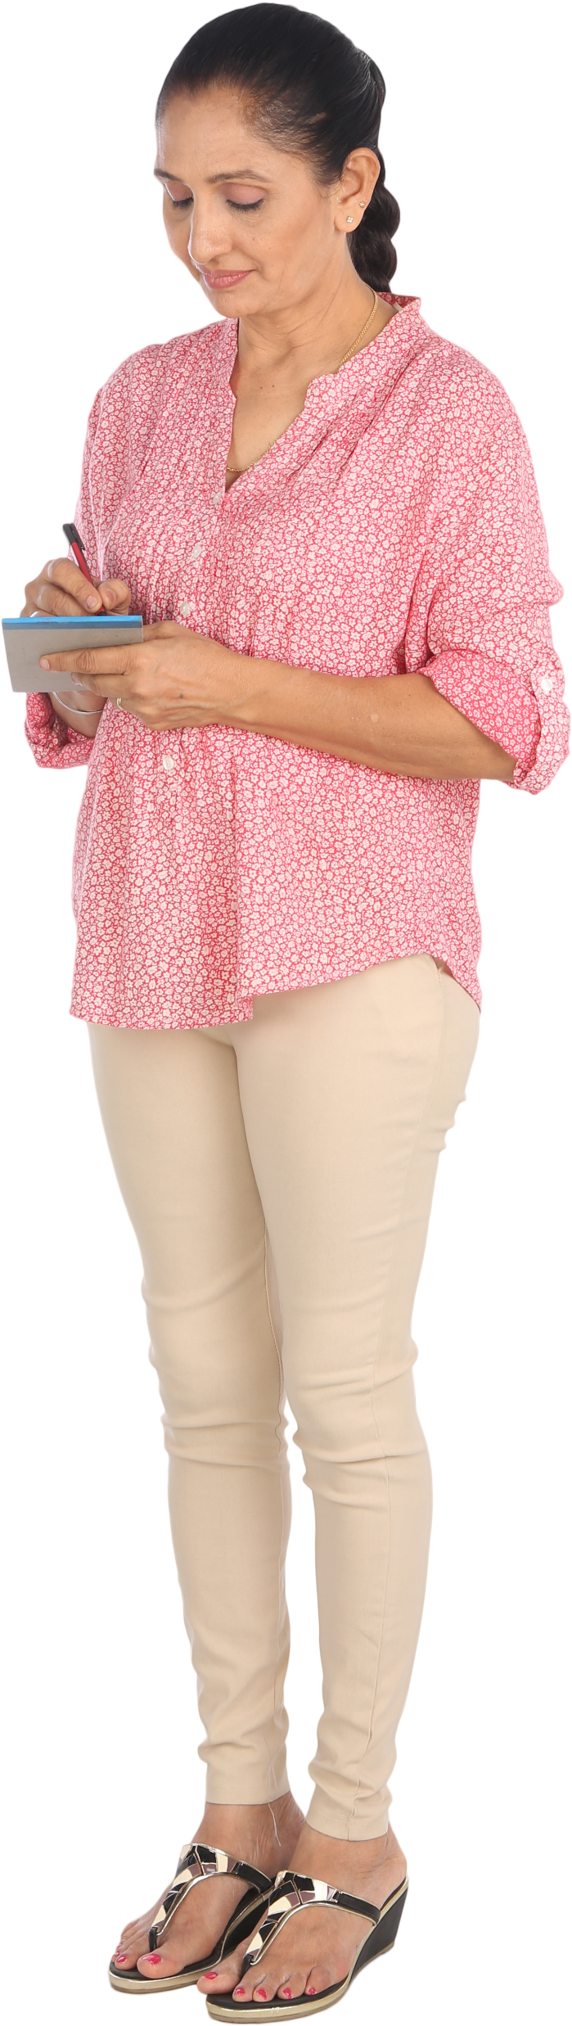
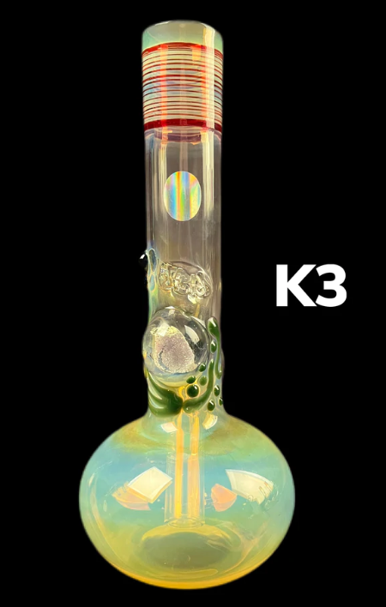
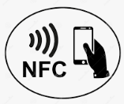

Retail to Customer interaction
Gasless, SMS, Near Field Communication, Email signup
Retail Mobile app
Customer Mobile app
What’s your mobile no?
917-555-5555
SMS via app w/link to Play/Apple Store
Downloads and installs
Email signup confirmation
No wallet or crypto
Gasless mint
No cost
Invoice using existing payment systems
NFT transfer
Pays using Credit Card
Customer confirms receipt on app

Slide 8
Event or Concert
Gasless, SMS, Near Field Communication, Email signup
Gate keeper at Concert
Attendee – QR Code
What’s your mobile no?
917-555-5555
SMS via app w/link to Play/Apple Store
Downloads and installs
Email signup confirmation
No wallet or crypto
Gasless mint
No cost
Invoice using existing payment systems
NFT transfer
Pays using Credit Card
Customer confirms receipt on app

Slide 9


DB
Txn Hash
0xfdca ..
F
G
Marketplace.sol
3
4
6
8
Moralis Indexer
Brand
C
Brand
GUID
UserName
5
AnyGUID
Fee (Token)
A
Brand
Brand
E
1
Txn Hash
0xfdca….
D
B
QR Code
UserName
NFT.sol
Requestor
Authenticator. sol
QR Code
I
Brand
Hash(GUID + QR Code)
2
H
J
True/False
Brand
QR Code
7
Hash(AnyGUID + QR Code)
Blockchain

Slide 10




Metasalt DB
Brand
D
Moralis
Indexer
BrandGUID
4
QR Code
E
3
5
Txn Hash
0xfdca ..
C
Brand
BrandGUID
F
16
Brand
6
B
UserNameGUID
Brand
Marketplace.sol
NFT.sol
True/False
G
Hash(BrandGUID + QR Code)
QR Code
7
QR Code
11
8
12
A
9
ERC20
Fee (Token)
BrandGUID
13
BrandGUID
Brand
10
Brand
14
Authenticator. sol
1
2
Requestor
ERC20
Fee (Token)
ERC721
NFT Token
15
Brand
QR Code
H
Hash(BrandGUID + QR Code)
Blockchain
0x783eeb4ab271edeec0d44857e3f44208d34c8e3a5a8dbe98681fbfe536f439be

